Slide 1
.NET Competency

Slide 2
Training
Aricent page
Dynamic Table (HTML/DHTML).
Form validation (Javascript).
C #
  Calculator
  Online shopping.
ASP.NET
  List
  A Simple Calculator with GUI
  Online shopping

Slide 3
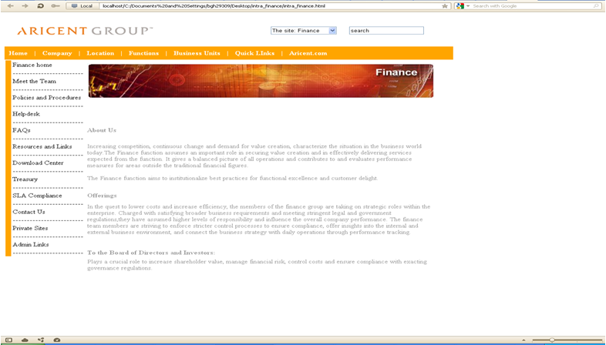
Aricent Page

Slide 4
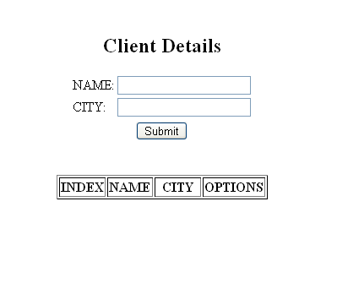
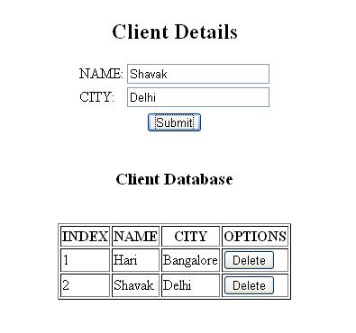
Dynamic Table (html/dhtml)

Slide 5
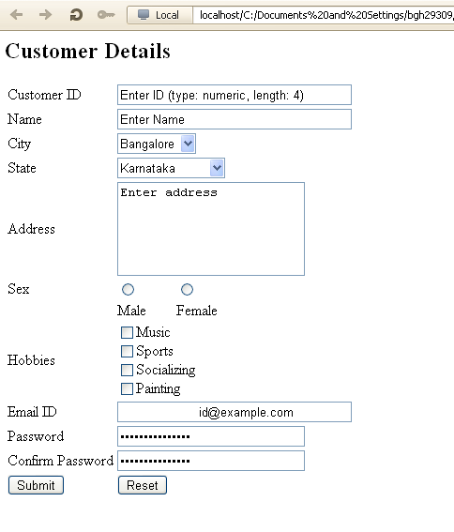
Form Validation : Javascript

Slide 6
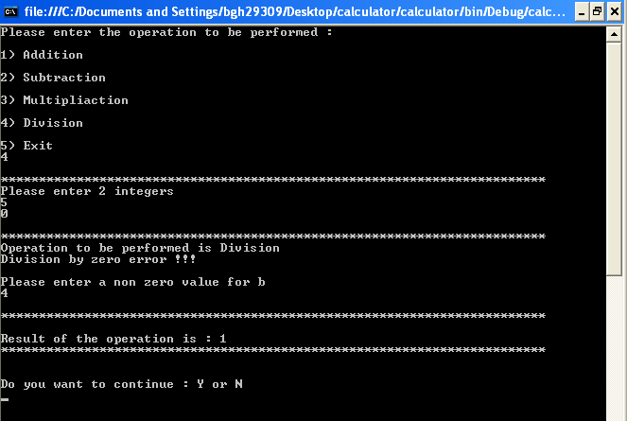
C# : Console - Calculator

Slide 7
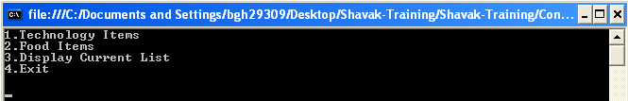
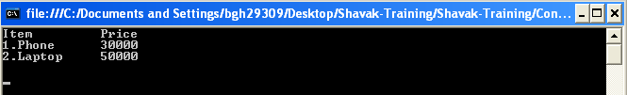
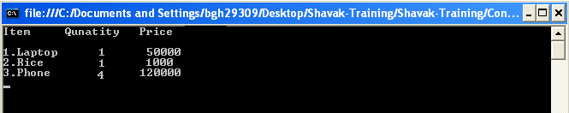
C# : Console – Online Shopping

Slide 8
Asp.net Training
List.
A simple Calculator.
Online shopping.

Slide 9
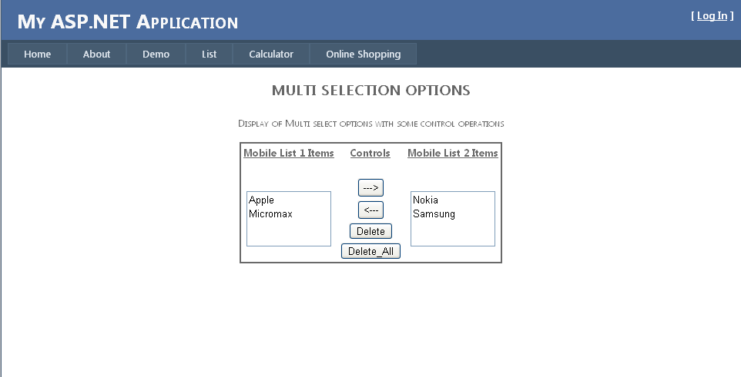
List Demo

Slide 10
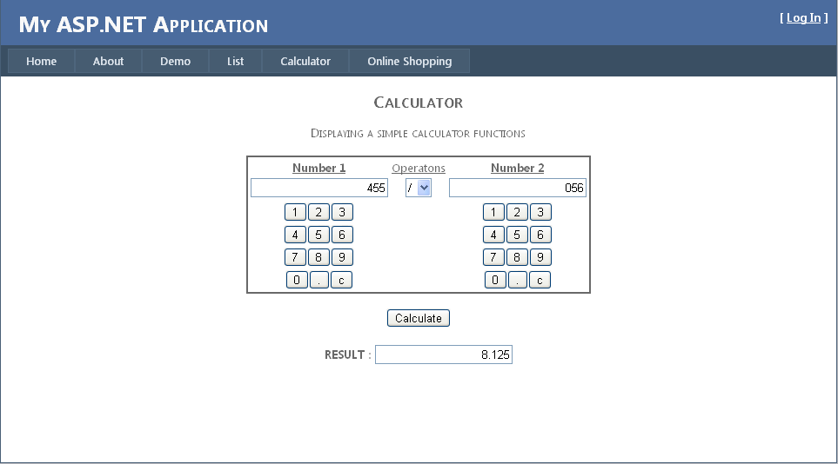
A Simple Calculator

Slide 11
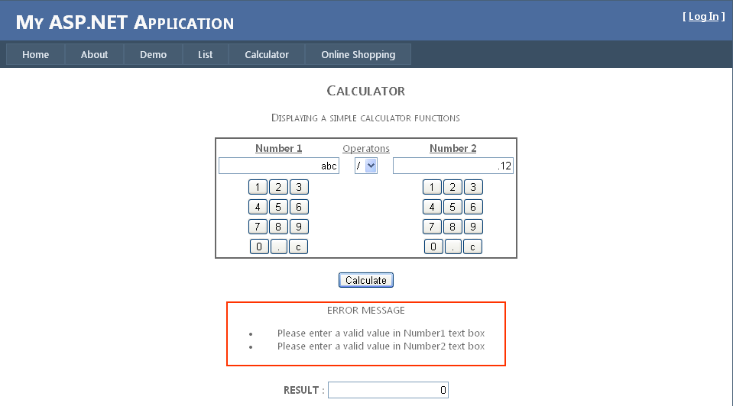
A Simple Calculator :Error Handling

Slide 12
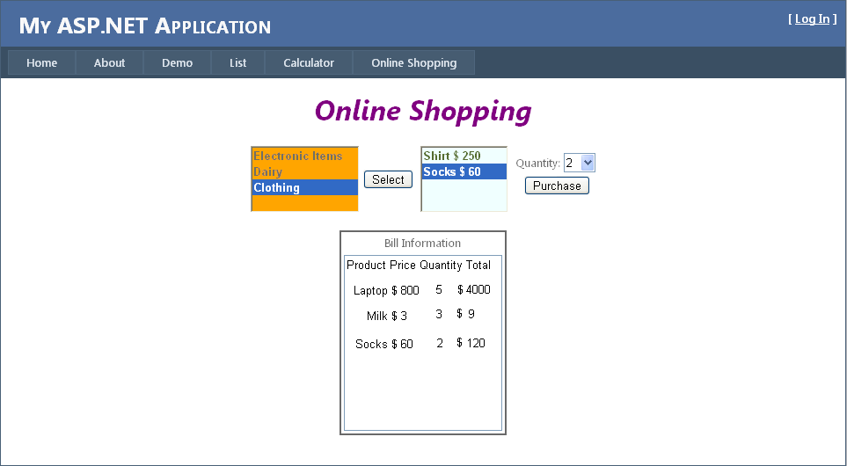
Online Shopping

Slide 13
Thank You
Notes:
Guidelines
The Program Review (PMR) is conducted monthly for all key functions to provide visibility to the Sr.Mgmt on the progress, performance, trends, risks and issues of the functions; the review is done against the function objectives, goals and plans; it helps the team and other stakeholders to take any course correction.
The Program review is held by the Function Head. Participants include the whole functional team.
The program review inputs (PPT/Report, support documents) to be circulated to all the participants in advance by the Function manager.
Participants are expected to come prepared for the meeting with specific queries/updates/resolution (for effective utilization of meeting time)
The recommended duration for program review is not more than 1 hour
The action item arising out of the Program review is recorded as part of the program review PPT and circulated to all the participants by the Function Manager
Function Manager tracks to closure the identified action items.
The Program review schedule will be published in the Intranet during the last week of every month and status updated periodically by QA.

